Slide 1
Corona virus analysis
Presented By:
Bhavana Kurabet

Slide 2
Introduction
Coronavirus disease 2019 (COVID-19) is a contagious disease caused by the coronavirus SARS-CoV-2. The first known case was identified in Wuhan, China, in December 2019.
The corona virus pandemic has reshaped daily lives globally.
The disease quickly spread worldwide, resulting in the COVID-19 pandemic.
It has had serious impact on public health and has created an urgent need for data driven insights to understand the spread of the virus. This analysis of corona virus data using SQL aims to uncover key insights into its spreads and demographic impacts.
Join us to explore critical aspects of the pandemic and understand its implications for decision making and response strategies.

Slide 3
Overview
Check for NULL values and update.
Total number of rows.
Start and End date.
Number of months present .
Monthly averages of cases.
Most frequent values by month.
Minimum and maximum values per year
Total cases per month.
Spread analysis with respect to Confirmed, Deaths, Recovered cases.
Country level analysis.
Top 5 countries with highest Recovered cases.

Slide 4
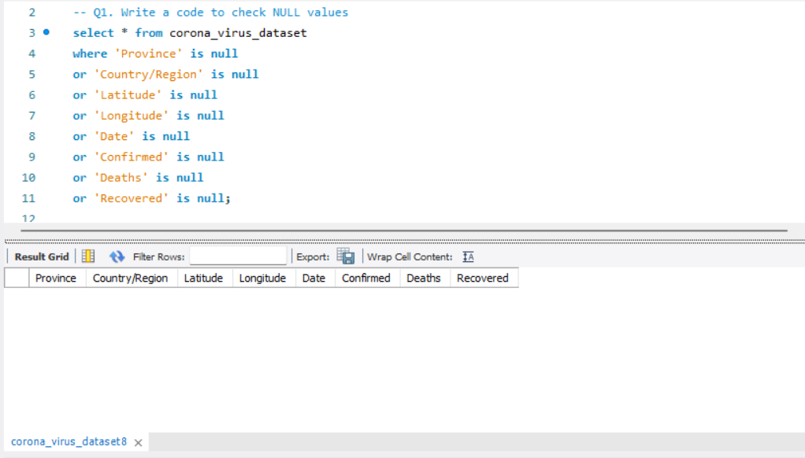
1. Write a code to check NULL values

Slide 5
2. If NULL values are present, update them with zeros for all columns.
NO NULL VALUES PRESENT

Slide 6
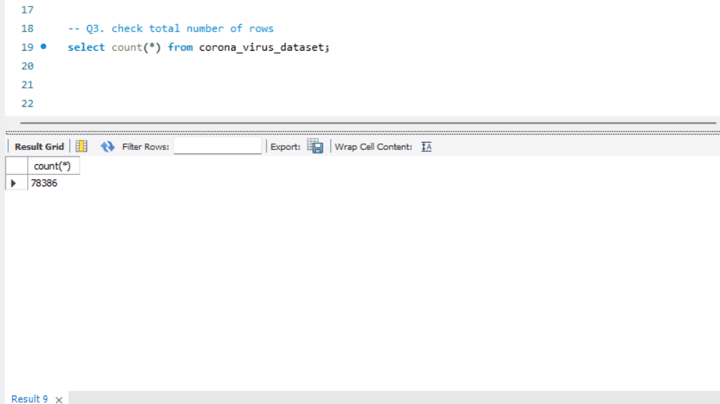
3. check total number of rows

Slide 7
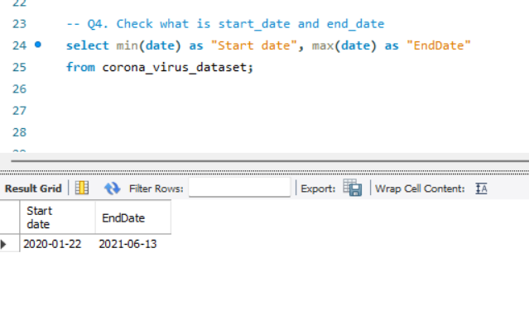
4. Check what is start_date and end_date

Slide 8
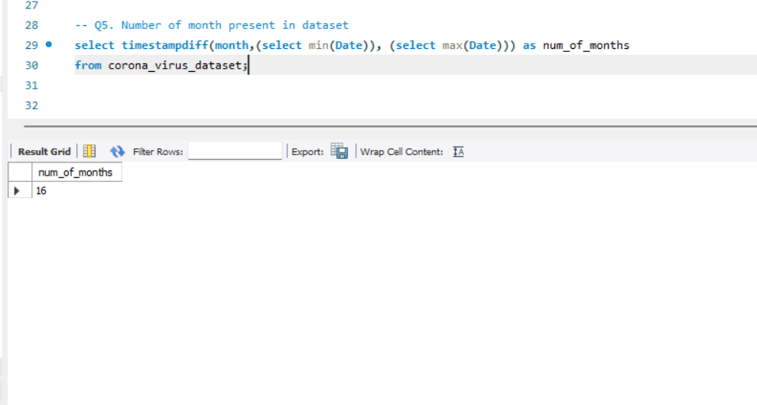
5. Number of month present in dataset

Slide 9
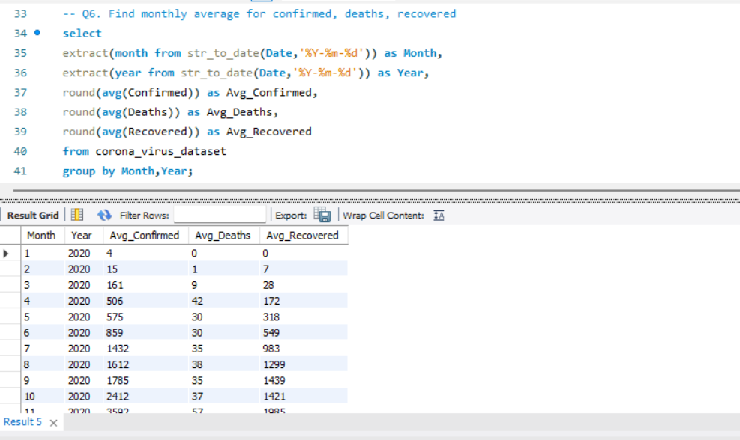
6. Find monthly average for confirmed, deaths, recovered

Slide 10
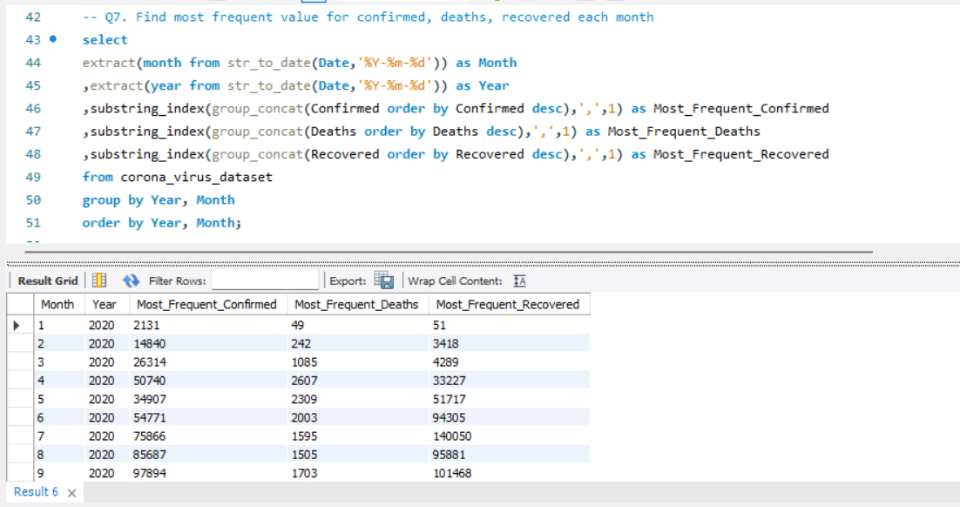
7. Find most frequent value for confirmed, deaths, recovered each month

Slide 11
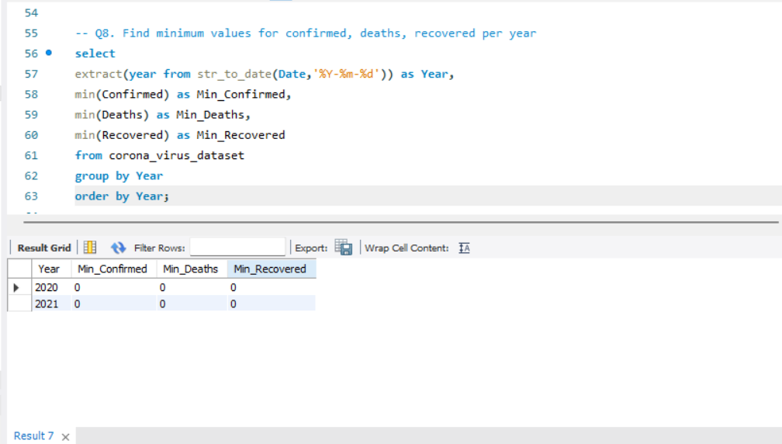
8. Find minimum values for confirmed, deaths, recovered per year

Slide 12
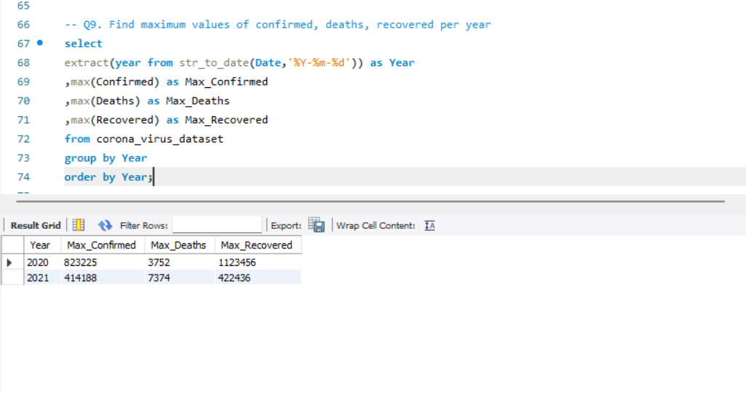
9. Find maximum values of confirmed, deaths, recovered per year

Slide 13
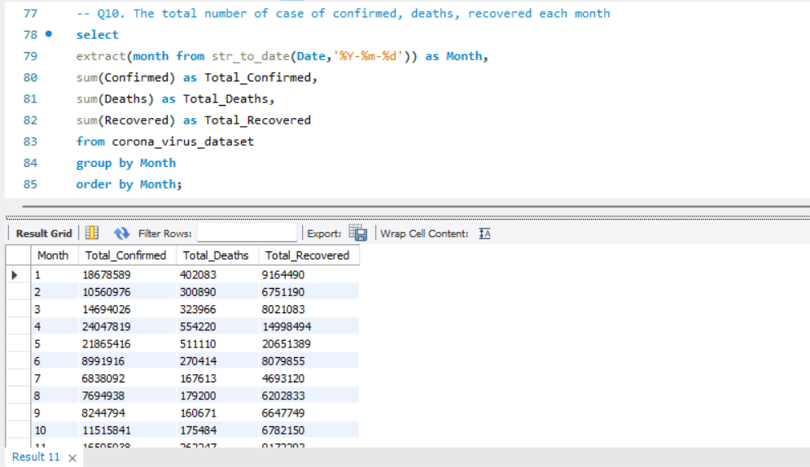
10. The total number of case of confirmed, deaths, recovered each month

Slide 14
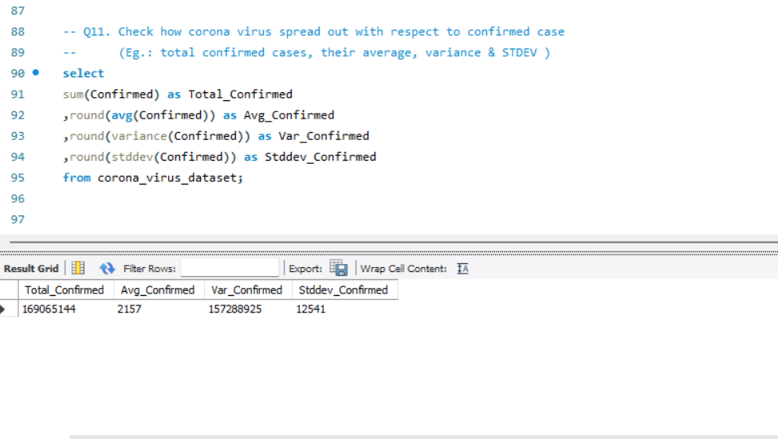
11. Check how corona virus spread out with respect to confirmed case

Slide 15
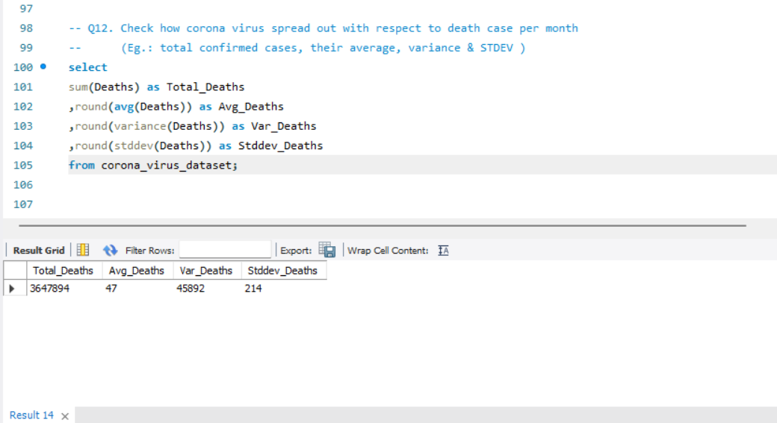
12. Check how corona virus spread out with respect to death case

Slide 16
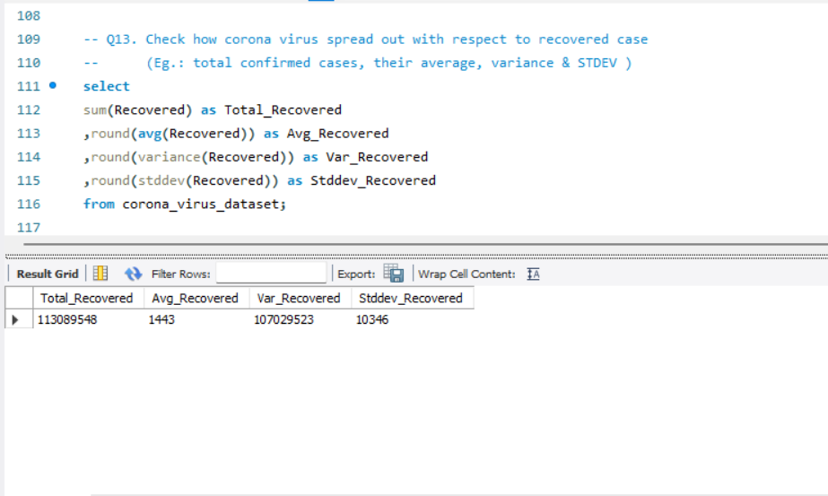
13. Check how corona virus spread out with respect to recovered case

Slide 17
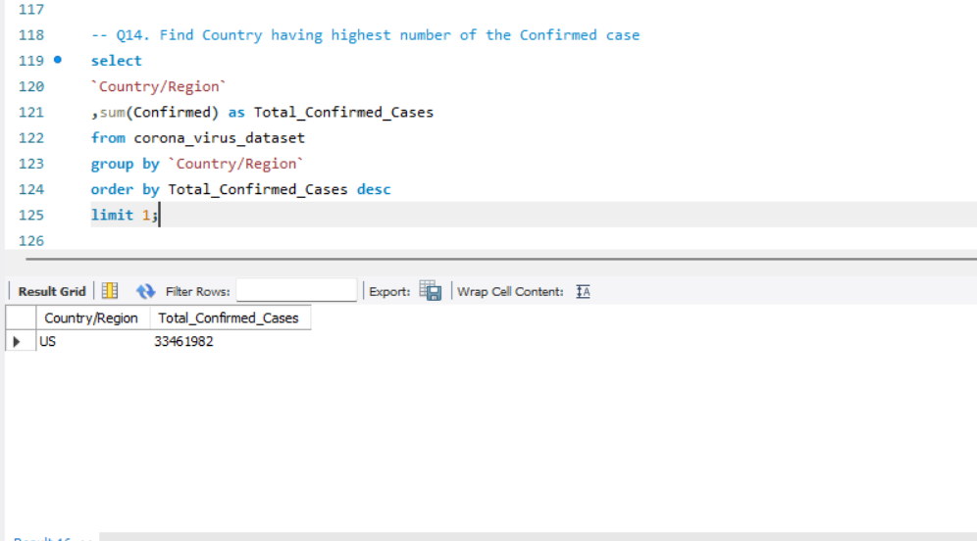
14. Find Country having highest number of the Confirmed case

Slide 18
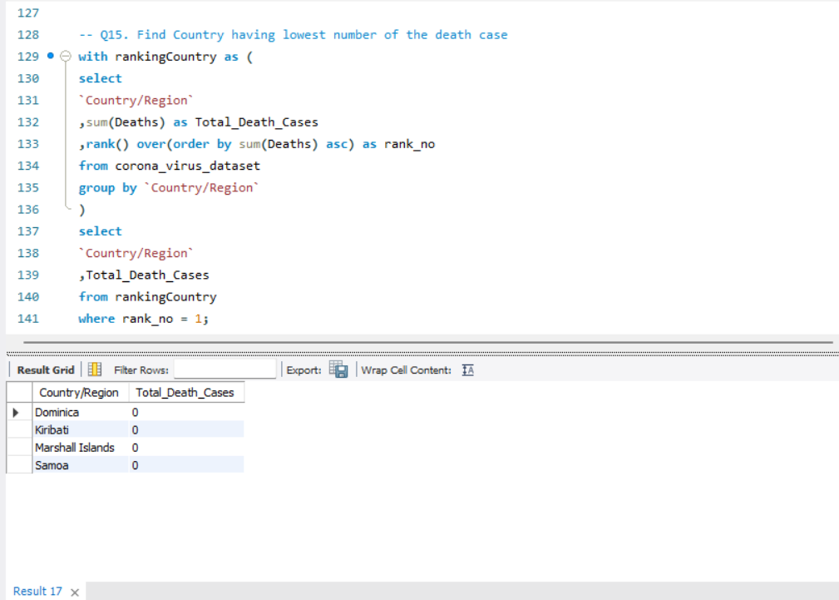
15. Find Country having lowest number of the death case

Slide 19
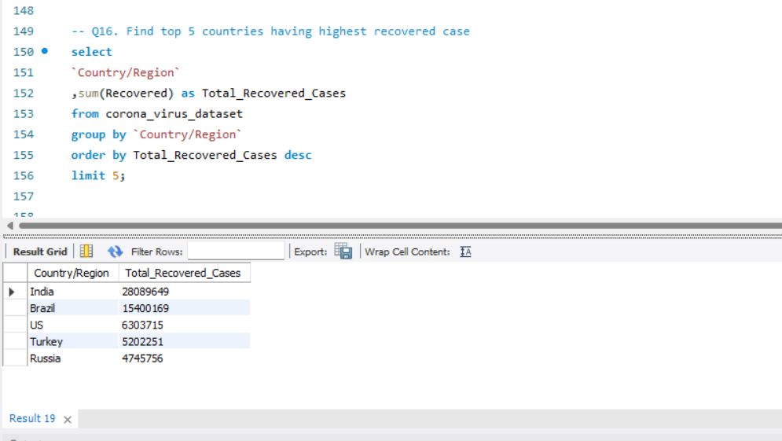
16. Find top 5 countries having highest recovered case

Slide 20
Key Insights
First outbreak was reported Jan 2020.
Maximum confirmed cases were in the year 2020 and the maximum death cases were in the year 2021.
US had the highest number of confirmed cases.
Dominica had the lowest number of death cases.
India performed best in case of recovery.

Slide 21


